Slide 1

Week 10
LO.4 - Developing a range of core employability skills reflecting compassion, values and behaviours.

Slide 2

What does employability skills mean?
Identify employability skills needed in Healthcare sector?

Slide 3
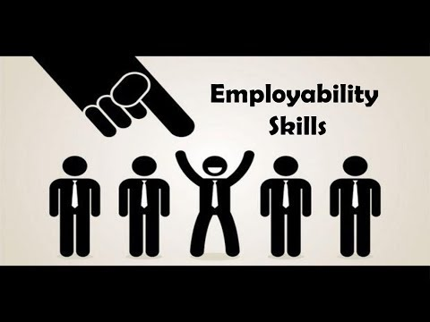

Slide 4
Week 10
LO.4 - Developing a range of core employability skills reflecting compassion, values and behaviours.

Slide 5

Aim;
Critically analyse progress in developing a range of core employability skills reflecting compassion, values and behaviours.
Learning outcomes;
At the end of this lesson students will be able to:
Exploring a range of core employability skills in healthcare practice
2. Analysing core employability skills that reflects compassion, values and professional behaviours of health and social care professionals

Slide 7


Slide 8
Employability skills
Employability skills are transferrable skills that are useful in nearly every job. They involve the development of an expertise, knowledge base or mindset that makes you more attractive to employers.
Employability skills are also often referred to as employment skills, soft skills, work-readiness skills or foundational skills.
They often improve your performance, minimize errors and promote collaboration with your co-workers, enabling you to perform your role more effectively.
Employability skills may not be listed in a job description, but they are important skills that can make you more attractive to prospective employers.

Slide 9
What is employability
Employability is ‘a set of achievements
– skills, understandings and personal attributes
– that make graduates more likely to gain employment and be successful in their chosen occupations, which benefits themselves, the workforce, the community and the economy. (Yorke, 2004, page 21).
A common misconception about employability is that it is the same as being employed and getting a job, or that having high levels of employability will guarantee you a job. As is it clear from the definition, employability is more an ongoing state of being capable to exist and build success in job market.

Slide 10
Are attributes which improve individuals’ ability to:
Gain employment
be effective at their jobs
Attain upward movement in their fields
Are often linked and complementary
Any contribute to one another and when one improves it may positively influence others
Employability Skills

Slide 11
The main benefit of having these traits is that it can help you stand out among other job candidates who are vying for the same position.
While other candidates may have the same qualifications and experience, you may have a better chance of getting hired if you have employability skills that are particularly useful for the role.
Certain employability skills are more sought after in specific industries.
You can prepare yourself for an interview or write your resume for a particular position by researching which employment skills are essential in your industry.
Employability skills benefits

Slide 12
Healthcare professionals will understand how employability skills enhance their employment opportunities and job satisfaction.
They will demonstrate key employability skills and will maintain and upgrade skills, as needed.
Classify the personal traits or attitudes desirable in a member of the healthcare team.
Why do we need to know about employability skills in healthcare?

Slide 13
A successful career in health care takes more than a top-notch degree program or hands-on training.
Employers of health care workers are looking at more on your resume than just your clinical abilities.
It’s also important you develop your so-called “soft skills,” which can also be called “personality skills.”
These are the personal attributes you use to influence and enhance the way you communicate and relate to patients, colleagues and peers.
Soft skills can impact your career prospects, your job performance and other activities in life.
Employers are often looking for soft skills in addition to qualifications.
In many professions, including health care, your soft skills can help your career progression over time more than your technical skills.
Cont..

Slide 14
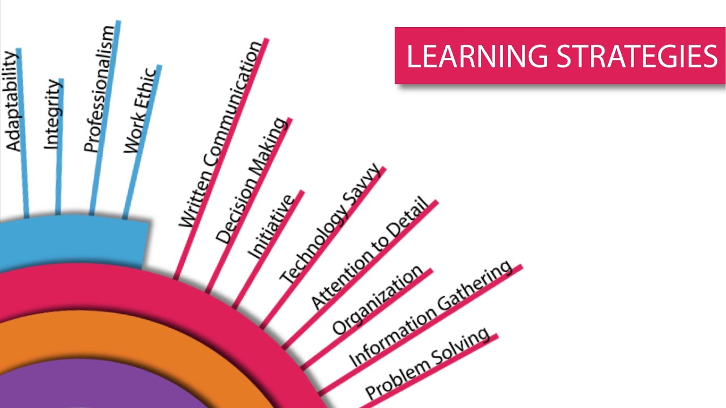

Slide 15
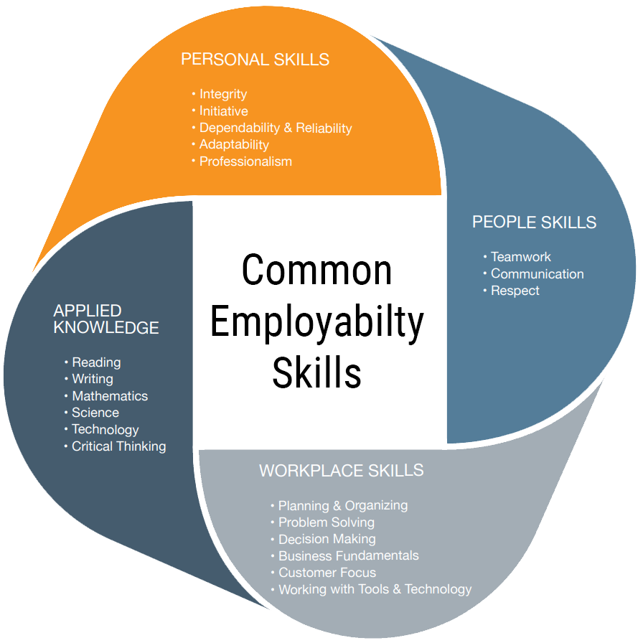

Slide 16
For healthcare workers, there is often a tendency to focus on hard skills, or skills directly related to job duties.
However, the success of a doctor’s office, hospital, or other healthcare institution often depends on “soft skills,” which are skills related to emotional intelligence, interpersonal communication, social skills, and general attitudes.
These skills can help healthcare workers to better serve patient populations and improve the efficiency of the healthcare practice.
Below, you will learn about some of the soft skills that are instrumental in developing your career in the health professions.
Important “Soft Skills” to Develop as a Healthcare Worker

Slide 17
Employers have high regard for employability skills because they are much harder to teach than job-specific skills. Some employable qualities come naturally, while others can be acquired through education, work or daily practice.
You may already have some of the key employment skills, but you can work to improve those skills and develop new ones. Here are 10 common employability skills that employers look for:
Communication
Teamwork
Reliability
Problem-solving
Organization and planning
Initiative
Self-management
Leadership
Learning
Technology
Examples of employability skills

Slide 18
Healthcare professionals will understand how employability skills enhance their employment opportunities and job satisfaction. They will demonstrate key employability skills and will maintain and upgrade skills, as needed.
Personal Traits of the Healthcare Professional
A. Personal characteristics
1. Empathy
2. Honesty
3. Dependability
4. Willingness to learn
5. Patience
6. Acceptance of criticism
7. Enthusiasm
8. Self motivation
9. Tact
10. Competence
11. Responsibility
12. Discretion
13. Team)player
B. Time management
1. Setting goals
2. Time management plan

Slide 19
May be innate in some individuals, but may require active development in others
– for example, while some people are just naturally patient, others must work at it
Personal traits

Slide 20
Personal Traits
Are qualities of an individual’s personality
-Required in health care include:
– reliability
– enthusiasm
– integrity
– patience
– loyalty
– flexibility
– willingness to learn
– decision making

Slide 21

Reliability
Is the ability to be relied upon
an employee must be depended upon to complete tasks effectively
• Requires responsible behaviors including:
– being consistent and predicable
– following through on commitments and fulfilling obligations promptly – attending to details and correcting errors
– following instructions and complying with organizational policies

Slide 22

Enthusiasm
Refers to active interest and excitement
– regarding the organization, job, client, etc.
• Requires motivated behaviors including:
– maintaining a positive attitude
– taking initiative to recognize and complete work needing to be done
– investing emotionally in tasks and outcomes
– committing to optimized performance and continuous improvement

Slide 23

Integrity
Is the quality of being honest and adhering to ethical and moral principles
– Regardless of the situation or possible consequences
Requires trustworthy behaviors including:
– Maintaining high standards for acceptable behavior in all aspects of work and life
– Being transparent and open to critique
– Admitting mistakes and using them to improve
– Sharing recognition with others when appropriate

Slide 24
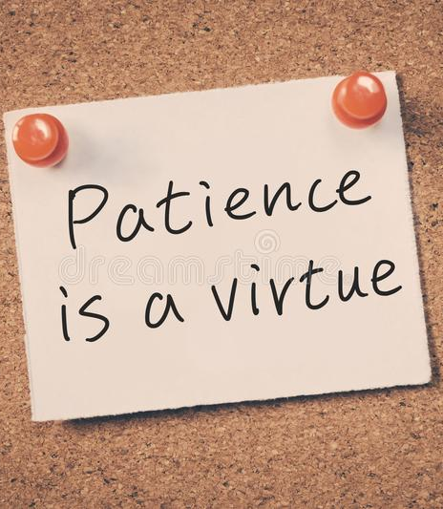
Patience
-Refers to the ability to accept and tolerate delay, interruption or misfortune
– Without displaying annoyance and frustration
Requires easy-going behaviors including:
– Listening to others respectfully
– Considering all options and perspectives before acting
– Approaching conflicts with a calm, constructive attitude
– Avoiding irritability and complaining when experiencing difficulties

Slide 25
Loyalty
Is the quality of being committed to providing support and allegiance – to a person, group of people or organization
• Requires dedicated behaviors including:
– supporting decisions through active listening and positive feedback
– being willing to contribute to any task
– giving extra time and energy needed to exceed expectations
– refraining from gossip and slander

Slide 26

Flexibility
Refers to the willingness and ability to readily adapt as circumstances and expectations change
Requires responsive behaviors including:
– modifying work style based on the demands of the situation
– recognizing and incorporating successful techniques of
– multi-tasking without sacrificing quality of work
– offering to work overtime or change work schedules to accomplish goals

Slide 27
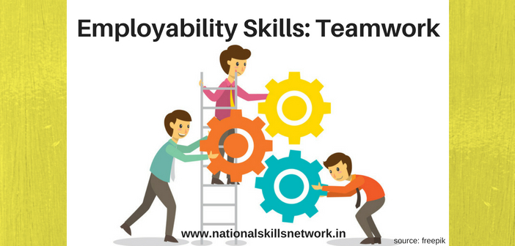
Team work
Is cooperation and collaboration among people to accomplish a shared goal
Requires unified behaviors including:
– recognizing strengths and capabilities of each team member
– distinguishing roles and responsibilities and being accountable for their fulfilment
– organizing and sharing resources efficiently
– expressing appreciation for the contributions of all team members

Slide 28

Willingness to learn
Refers to a desire and commitment to obtain any necessary knowledge and skills
Requires inquisitive behaviors including:
– demonstrating interest in peers’ methodologies and skill sets
–asking questions and taking notes in meetings and other group settings
– taking on new challenges with confidence
– participating in professional workshops, continuing education and training opportunities

Slide 29

Decision making
Is the ability to select an effective choice from available options
– by analyzing needs and available options
Requires resolute behaviors including:
– keeping an open mind by avoiding assumptions and biases
– developing and implementing systematic decision-making processes – evaluating and learning from past decisions
– investigating and considering diverse perspectives, especially those with experience or expertise

Slide 30

Personal traits
Can be improved by:
– Identifying necessary areas of improvement
- Maintain self-awareness
– Noticing positive traits in others and modeling their behaviors
Ask for advice when appropriate
– Finding situations requiring traits and using them to practice
• Get out of comfort zone to work on improving

Slide 31
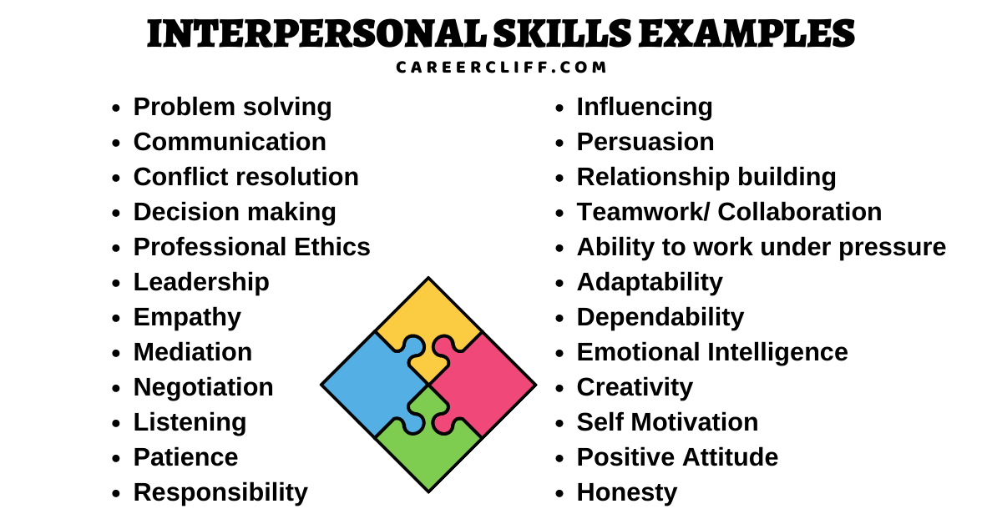
Interpersonal skills

Slide 32
Are developed continuously during every social interaction in a person’s life
– Good and bad habits are formed over time
• Can influence professional and social aspects of an individual’s life
– Good interpersonal skills lead to better relationships
Interpersonal skills can be improved by:
– Developing emotional intelligence
• Understand one’s own emotions, the emotions of others and how emotions affect attitude and behavior
– Maintaining a good attitude
• Smile and be happy to help boost others’ moods
– Practicing continuously
• Socialize often and consider every interaction an opportunity to strengthen abilities
Interpersonal skills

Slide 33

Interpersonal skills
Are abilities which enable effective interaction
Needed in health care include:
– Respect
– Communication
– Teamwork
– Empathy
– Tact
– Leadership
– Conflict resolution

Slide 34
Respect
Refers to conduct which demonstrates regard for a person, organization, etc.
– because of their good qualities and abilities
Requires courteous behaviors including:
– Treating everyone with dignity at all times
– Being considerate of needs and feelings
– Encouraging others to express their opinions and ideas
– Refraining from insulting, belittling or antagonizing others

Slide 35

Communication
Refers to the methods used to exchange information
– includes verbal, nonverbal, written, etc.
Requires focused behaviors including:
– selecting the best medium for the message
– listening actively
– being mindful of body language, eye contact, hand gestures and other nonverbal signals
– providing and encouraging constructive feedback

Slide 36

Empathy
Is the ability to recognize and understand the feelings of others • Requires considerate behaviors including:
– maintaining self-awareness regarding the treatment others
– actively listening to others
– validating others’ perspectives and emotions
– being authentic and genuine during interactions with others

Slide 37

Tact
Refers to the ability to handle delicate situations appropriately – without causing distress or offense
Requires sensitive behaviors including:
– using empathy to identify situations in which others might be uncomfortable or defensive
– planning difficult conversations by determining the preferred outcome and considering possible reactions
– communicating mindfully to avoid being hurtful, aggressive or confrontational
– maintaining control of emotions and avoiding emotional reactions

Slide 38

Leadership
Is the ability to manage, support and guide a group of people to accomplish goals
Requires motivating behaviors including:
– being accountable for all actions
– focusing on organizational goals and incorporating them into personal goals
– contributing a significant amount to group efforts while encouraging equal participation among members
– demonstrating interest in the work of each individual team member

Slide 39
• Refers to the strategies used to find peaceful solutions to disagreements
Requires objective behaviors including:
– listening actively in attempts to understand opposing opinions
– Expressing views firmly without being disrespectful or aggressive
– Maintaining an open, positive mindset
– Asking for mediation or arbitration from an uninvolved third party
Conflict resolution

Slide 40

Activity
Reflect on the personal attributes adult care workers have where you work.
How many of these personal qualities do you also have?
Are there any of these that you don’t have?

Slide 41
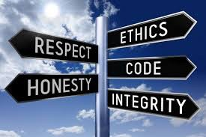
Professional Standards

Slide 42
Professional Standards
Are achieved through habitual practice
– Many can become second nature when incorporated into routines
Can be improved by:
– Establishing good habits
– Maintaining self-awareness
– Observing other professionals
– Getting guidance from a respected mentor

Slide 43
Are expectations regarding workplace practices
In health care include: –
Occupational awareness and adherence
– Responsible substance use
– Hygiene
– Workplace attire
– Etiquette
– Time management
– Competence
– Discretion
Professional Standards

Slide 44
e
Refers to understanding and adhering to the needs of a specific profession
Requires conforming behaviors including:
– Seeking out information about occupational standards in health care fields
– Complying with occupational standards for conduct, knowledge and skills, scope of practice, licensing and certification, etc.
– Actively participating in professional organizations through meetings, conferences and training sessions
Occupational Awareness & Adherence

Slide 45
Is the avoidance of substance abuse as well as any substance use which affects job performance
Requires responsible behaviors including:
– Maintaining personal mental health
– Avoiding situations which may lead to substance use or abuse
– Recognizing risk factors for addiction
– Seeking treatment and support if needed
Responsible Substance Use

Slide 46
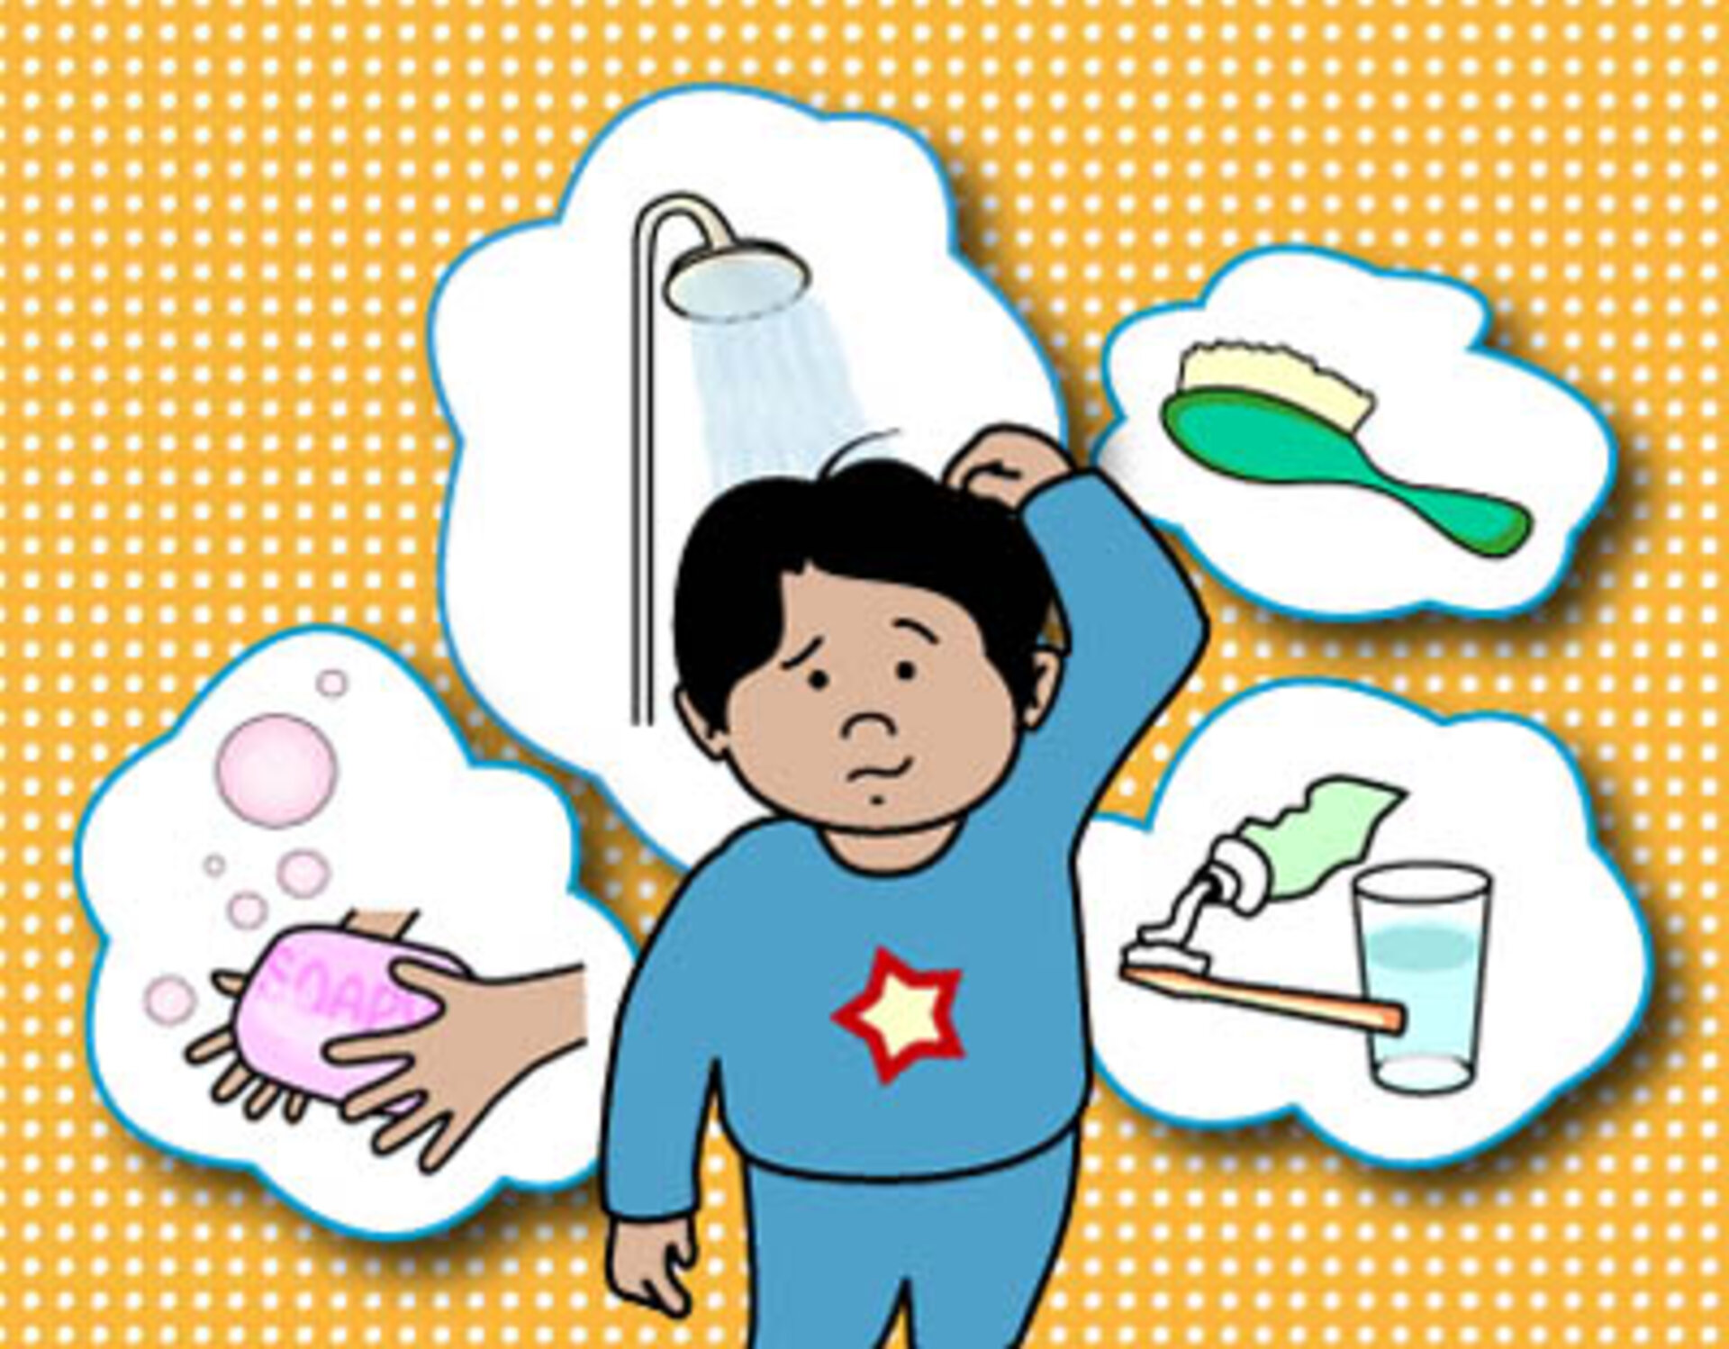
Hygiene
Refers to personal practices for maintaining cleanliness
Requires sanitary behaviors including:
– bathing or showering regularly
– brushing teeth and flossing regularly
– washing and maintaining hair, skin, nails and facial hair
– washing hands frequently

Slide 47

Workplace attire
Is clothing and accessories worn at work
Requires stylish behaviors including:
– Conforming to organizational policies regarding dress codes and uniforms – keeping clothing neat, clean and in good condition
– Wearing clothing and shoes suitable for job responsibilities
– Removing jewelry and covering tattoos as needed

Slide 48

Etiquette
• Refers to customary well-mannered social conduct
Requires polite behaviors including:
– demonstrating respect for others
– complying with organizational policies, procedures and codes
– following chain of command when discussing requests and complaints
– being punctual and prepared for appointments and meetings

Slide 49

Time Management
• Is the ability to use planning and organization to maximize efficiency
Requires systematic behaviors including:
– prioritizing goals and tasks
– establishing routines and good habits for smart use of time
– utilizing scheduling tools such as calendars, software and digital applications
– organizing systems and resources for efficient access and use

Slide 50

Competence
Is the ability to effectively apply knowledge and skills to perform specific functions and accomplish specific goals
Requires proficient behaviors including:
– developing and using procedures for completing tasks systematically – completing responsibilities in a manner which meets or exceeds expectations
– seeking out insightful mentors who can answer discerning questions – displaying confidence in abilities and work

Slide 51

Discretion
• Refers to the ability to use good judgement to avoid revealing private information or causing embarrassment
Requires sensitive behaviours including:
– Implementing policies and procedures which make confidentiality a priority
– Protecting private documents and materials
– Being mindful of who is in the room when discussing private information
– Avoiding discussion of controversial and inappropriate personal topics as well as gossip, prying and snooping

Slide 52
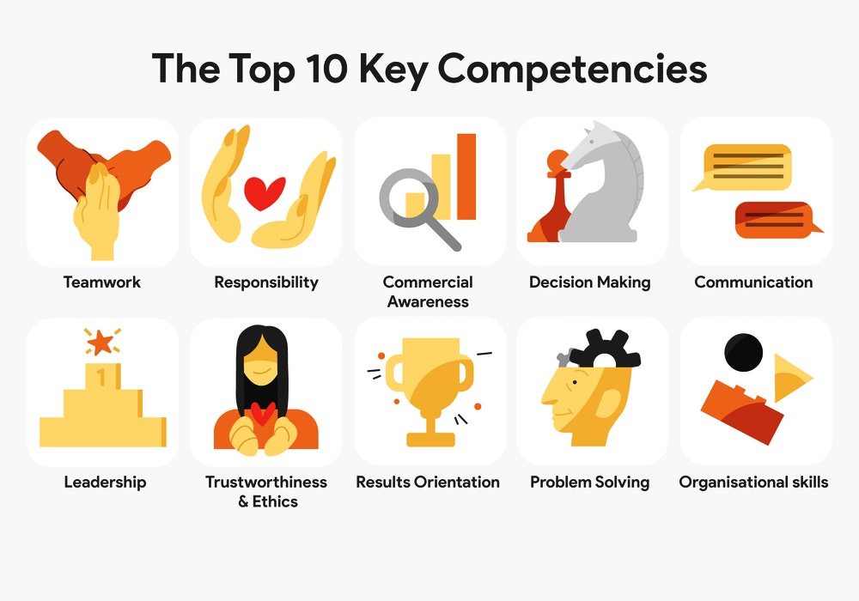
Academic & Technical Competencies

Slide 53
Refer to abilities related to specific work processes
Required in health care include:
– Fundamentals in science, technology, engineering and math (STEM)
– Basic computer operation
– Writing skills
– Knowledge of the health care system
– Ethics and law
– Safety
Academic & Technical Competencies

Slide 54
Require education and experience to develop
– therefore health care careers often require college
Can be learned through:
– High school and college courses
– Continuing education courses
– Professional development courses
– Employer training
– Self-led research, reading and instruction
Academic & Technical Competencies

Slide 55
STEM Fundamentals
Are used in the following ways:
– Measuring and calculating
– Conducting and analyzing research
– Examining complex systems
– Completing scientific processes
– Recognizing cause and effect relationships
Include:
– Algebra
– Statistics
– Biology
– Chemistry
– Physics
– Technology
What exactly is STEM?
STEM, it's one of the most talked about topics in education. But what exactly is STEM? STEM stands for Science, Technology Engineering, and Mathematics. ...
STEM moves beyond simple test performance and focuses on developing higher level thinking skills by connecting classroom learning to the real world.

Slide 56
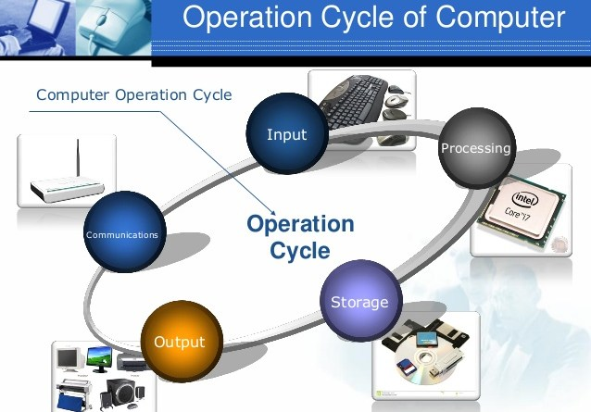
Basic Computer Operation
Is used in the following ways:
– Maintaining digital correspondence
– Using electronic health records
– Tracking employment details such as time off
Includes:
– Basic troubleshooting (restart, settings, etc.)
– Word processing programs
– Spreadsheet programs
– Database programs
– E-mail programs

Slide 57

Writing Skills
Are used in the following ways:
– communicating with co-workers, managers, insurance companies and others – documenting patient records
Include:
– proper grammar, spelling and punctuation
– accuracy and attention to detail
– technical terms and abbreviations

Slide 58
Is useful for the following:
– Directing patients to the most beneficial facilities, physicians, etc.
– Coding and billing correctly
– Optimizing organizational and personal practices to function within the system
– taking advantage of a wide variety of job opportunities
Includes:
– Types and structure of delivery organizations
– Types and organization of personnel
– Factors influencing systems
Knowledge of the Health Care System

Slide 59

Ethical & Legal Knowledge
Are necessary to ensure facilities and employees are legitimate and acceptable
Includes:
– Access to care
– End-of-life issues
– Scope of practice
– Ethics committees
– Clinical research and trials

Slide 60

Safety
• Is important to avoid injury and maintain health
Includes:
– medication precautions and procedures
– infection control
– positioning and ambulation techniques
– lab procedures
– methods for handling biological and chemical samples and waste

Slide 61
https://cookhealthscience.weebly.com/uploads/1/3/0/8/13084909/employability_skills_in_health_care-traits___characteristics.pdf
https://www.cipd.co.uk/news-views/changing-work-views/future-work/thought-pieces/compassion-workplace#gref
https://www.ed.ac.uk/reflection/reflectors-toolkit/employability

